Slide 1
2024-2025 ADVANCED LEARNING ACADEMY ADVISORY BOARD MEETING SEPTEMBER 25, 2024
Presentation by:
Amy Scruton
Principal

Slide 2
HISTORY
 | 2020-2021* | 2021-2022 | 2022-2023** | 2023-2024 | 2024-2025 ***
Grades | 3rd-12th | 3rd-12th | K-12th | TK-12 | TK - 12
Elementary | 51 | 36 | 59 | 87 | 106
Intermediate | 179 | 173 | 117 | 112 | 108
High School | 114 | 179 | 152 | 157 | 137
Total Enrollment | 344 | 388 | 328 | 356 | 351
Teachers | 21 | 23 | 25 | 25 | 28
Location | 1st Street (9-12) 4th Street (3-8) Circulos Grant-4 | Hoover (3-8) Walker (9-12) Circulos Grant-5 | Santa Clara (K-8) Bishop (9-12) | Santa Clara (TK-8) Bishop (9-12) | Santa Clara (TK-8) Bishop (9-12)
* * Distance Learning
** Addition of K, 1, and 2
*** Addition of elementary staff

Slide 3
Current Advisory Board Officers
Diana Torres- Board President
Alicia Skibby- Vice President
Gloria Lira- Member
Cheryl Whittington- Member
Bryan Davis- Member

Slide 4
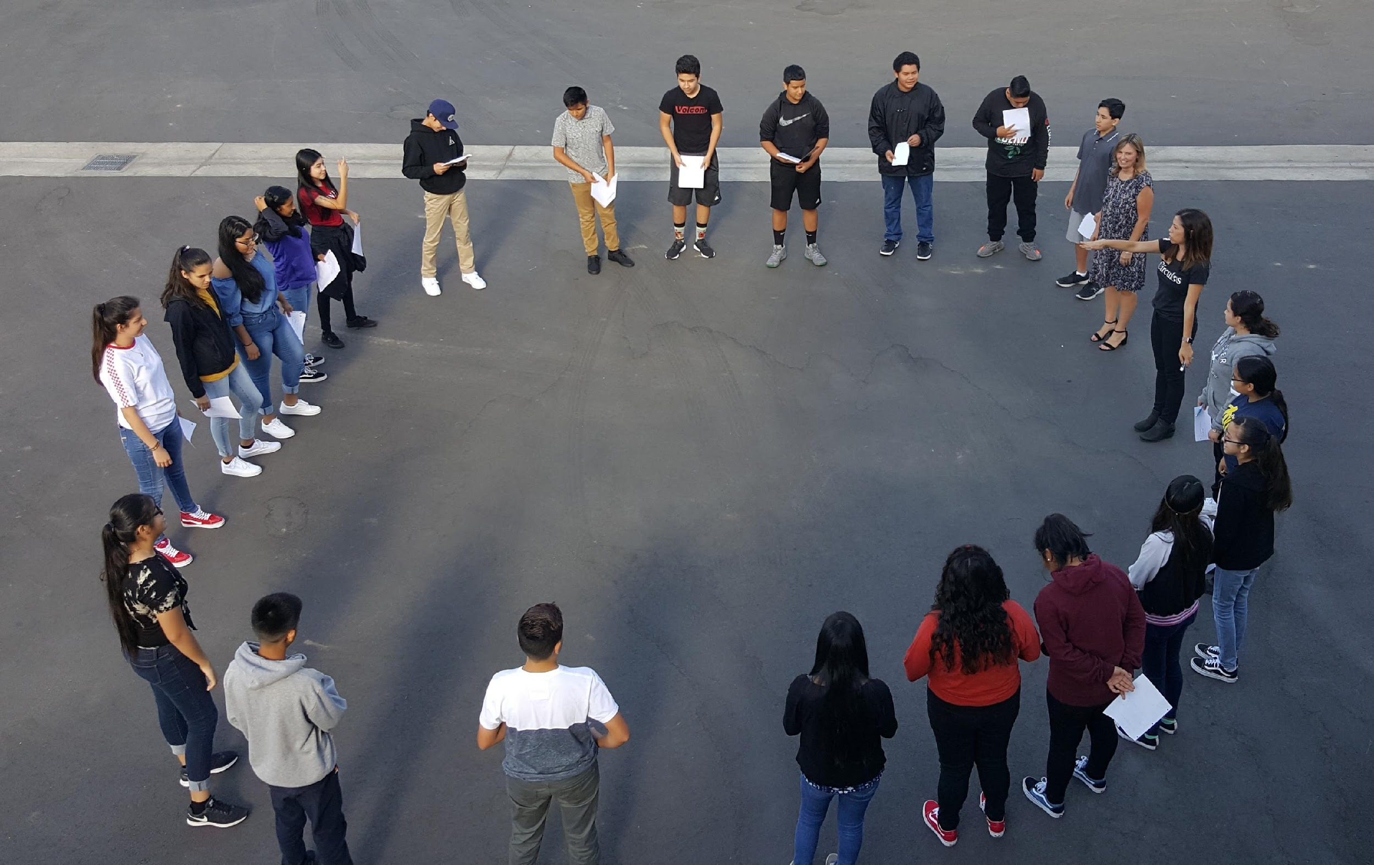
REVENUES:
LCFF Sources
Federal Revenue
Other State Revenue
Other Local Revenue
Total Reserves

Slide 5
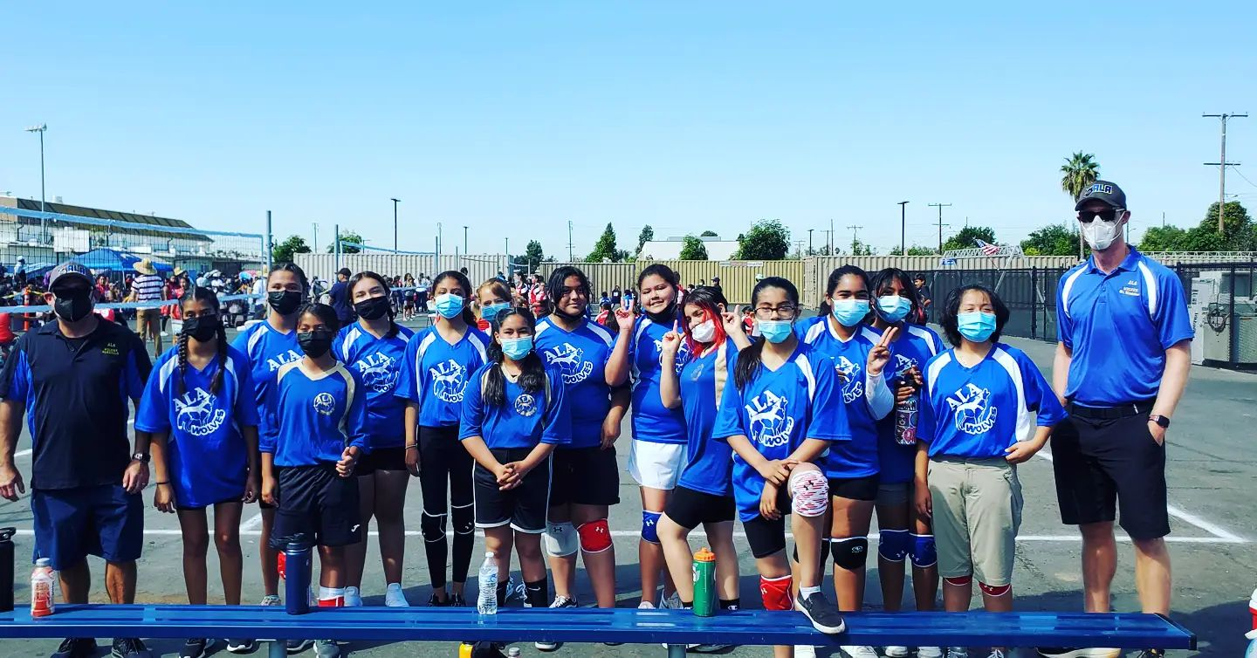
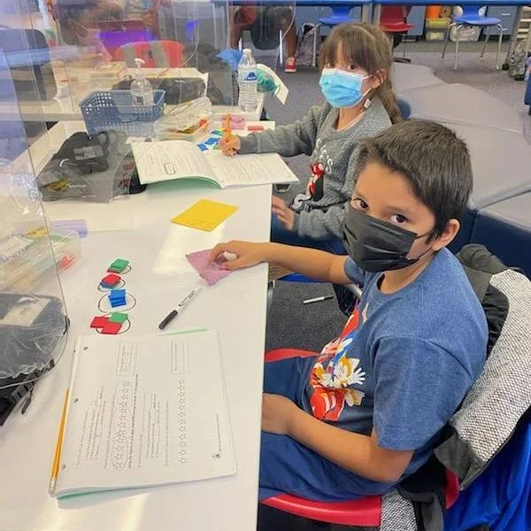
EXPENDITURES
Certificated Salaries
Classified Salaries
Employee Benefits
Books and Supplies
Other Outgo

Slide 6
COMPARABILITY
Charter Fund Revenue | Approved Budget | Unaudited Actuals | Variance | Explanation
LCFF Resources | $5.394 M | $4.952M | $95,754 | LCFF funds adjustment to reflect increase in projected enrollment
Federal Revenue | $57,093 | $385,253 | $3,367 | decrease in Title 1 allocation projected at EA
Other State Revenue | $973,987 | $998,905 | $90,121 | Increase of $22k in projected lottery funds and $45k on STRS, decrease in $157k in projected revenue earned for ASES program (spending down ELOP)
Other Local Revenue | $244,208 | $328,465 | ($14,271) | Increase due to fair value of investments adjustment at year end and slight decrease in projected interest income
Total | $6.669M | $6.664 M | $126,545

Slide 7
COMPARABILITY
Charter Fund Expenditures | Approved Budget | Unaudited Actuals | Variance | Explanation
CE and CL Salaries | $4.879 M | $4.060 M | ($313,136) | Decrease due to 1 FTE counselor budgeted twice by CTE, 3% estimate budgeted for possible SAEA negotiation. Lottery funded positions budgeted twice plus projected spending like sub courage, stipends
Employee Benefits | $2.311 M | $1.860 M | ($89,120) | Decrease due to salary changes noted above
Books and Supplies | $228,364 | $266,250 | ($169,206) | Decrease due to EXLD program requesting to use funds for consultant contractors instead of supplies at year end to spend down ELOP funds plus final remaining funds for ESSER ending in 2023-2024
Services and Other Operating Costs | $265,852 | $496,692 | $14,106 | Increase due to spending down ELOP funds
Indirect Costs | $409,014 | $340,574 | ($18,386) | Decrease due to budgeting of indirect costs
Total | $8,064 M | $7.024M | ($575,741)

